Slide 1
ZANIMIVA GRADIVA

Slide 2
Osebni izbor Matija Lokar za NAPOJ3

Slide 3
TWITTER

Slide 4
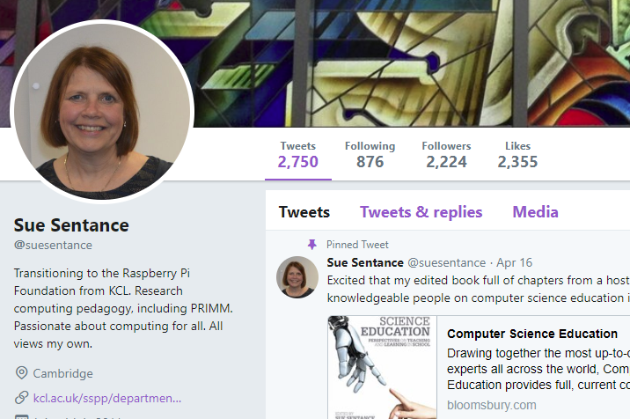
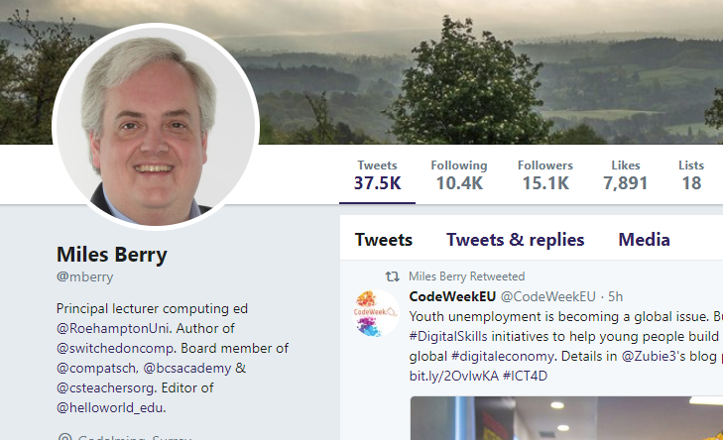
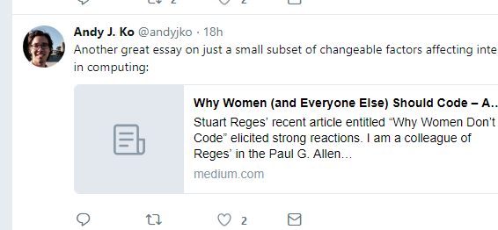
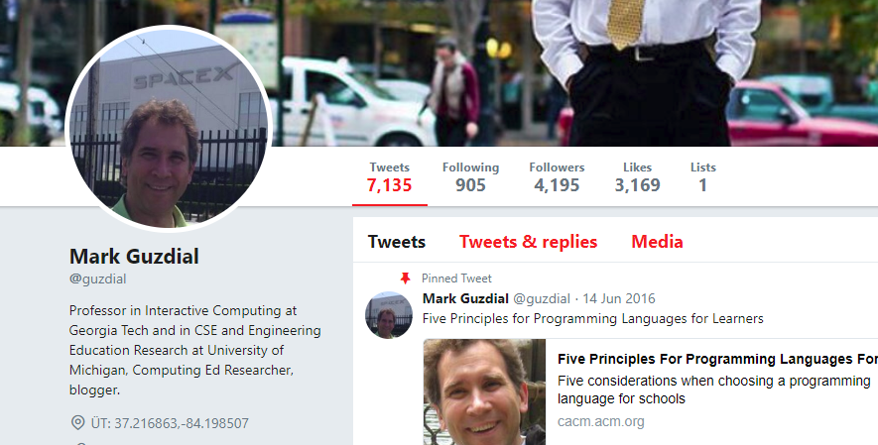

Slide 5
BLOGi

Slide 6
Computing Education Research Blog
Mark Guzdial
prof. CS na Georgia Tech (sedaj gre na U. Michigan)
Kolumnist v Communications of ACM
"media computation"
Bolj "raziskovalno" usmerjen blog, a zelo uporaben tudi za učirtelja RiN
Teaching Computer Science Better to get Better Results
Are you talking to me? Interaction between teachers and researchers around evidence, truth, theory, and decision-making
Why should we teach programming (Hint: It’s not to learn problem-solving)

Slide 7
Computer Science Teacher
Alfred Thompson
Učitelj CS na srednji šoli
Primeri iz prakse (aktivnega) učitelja CS
Precej solidnih komentarjev in razprav
How To Teach Computer Science
Programming With Blocks

Slide 8
Digiteacher
Dorian Love
Učitelj angleščine in ICT v Johanesburgu
Precej o IKT orodjih, o poučevanju naploh
Ključne besede
Learn to Code Online – Making Waves with Code Combat
Five Strategies to Avoid Digital Distraction in the Classroom

Slide 9
Bits and Behaviour
Andy Ko
University of Washington
Raziskovalec (tudi) področja CS v K-12
A parenting guide to CS learning
Why people shouldn’t learn to code
Why learn to code?

Slide 10
The 2018 Honor Roll: EdTech’s Must-Read K-12 IT Blogs

Slide 11
PORTALI

Slide 12
http://www.pd4cs.org/

Slide 13
https://www.teachthought.com/

Slide 14
http://csteachingtips.org/

Slide 15
ORGANIZACIJE/SKUPNOSTI

Slide 16
CSTA
Povezava z ACM
ACM Slovenija
CSTA's mission is to empower, engage and advocate for K-12 CS teachers worldwide.
https://www.csteachers.org/

Slide 17
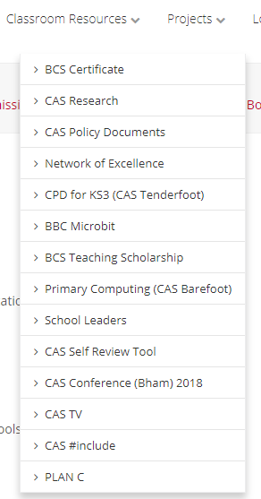
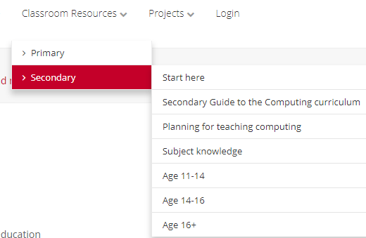
Computing at School
To promote and support excellence in computer science education

Slide 18
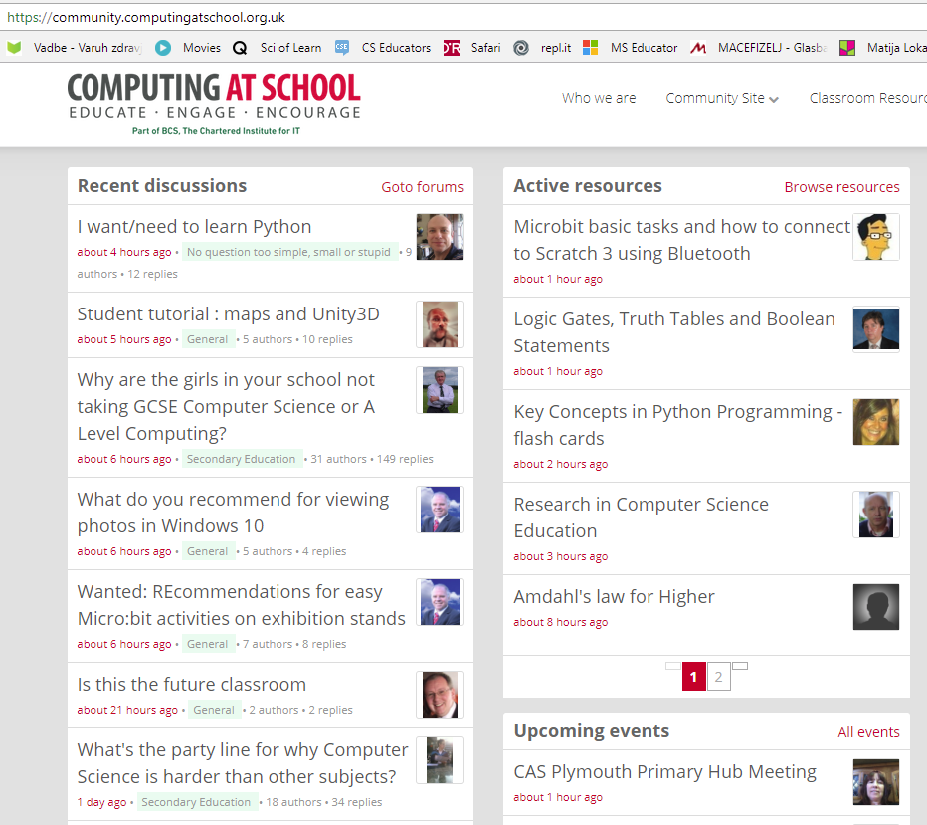
Skupnost "kot se šika"

Slide 19
Special Interest Group on Computer Science Education
ACM
https://sigcse.org/sigcse/
Konferenci ITiCSE in ICER

Slide 20
ČLANKI

Slide 21
KONFERENCE/ZNANSTVENE REVIJE/REVIJE

Slide 22
Strokovne revije
ACM Inroads
Portnoff, The Introductory Computer Programming course is First and Foremost a LANGUAGE Course
Revija Hello World
HW5: New times demand new educational approaches (56-57)
HW5: Flow control in primary programming (66 – 68)
HW1: Jungle maze solver(50 – 51)
HW1: Quantum: tests worth teaching to + project Quantum – a teacher’s perspective (40 – 41)
HW4: Approaches to professional development (18 – 27)

Slide 23
Znanstvene revije
glej spisek na https://sigcse.org/sigcse/resources/publish

Slide 24
Zborniki konferenc
Pogosto povezave do zbornikov z "domačih strani"
ITiCSE
ICER
ISSEP
WiPSCE
Veliko na ACM Digital Library
Določeni prispevki prost dostop …

Slide 25
Google scholar (Learning + Technology (LeTech) – Aalto University Finska)
J. Sorva, Misconceptions and the Beginner Programmer
Jsvee & Kelmu: Creating and tailoring program animations for computing education

